Slide 1
FLEXBOX

Slide 2

Agenda
What & Why
How
Exercise

Slide 3
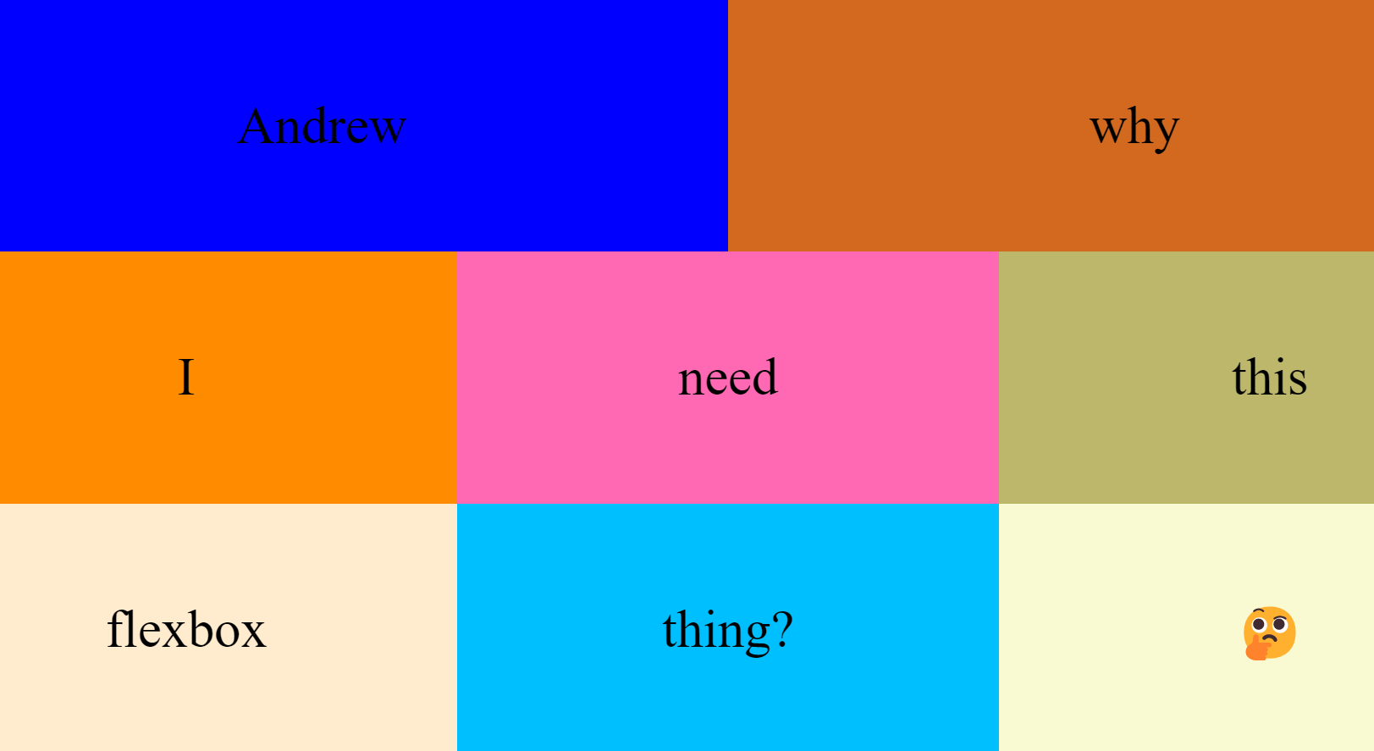

Slide 4
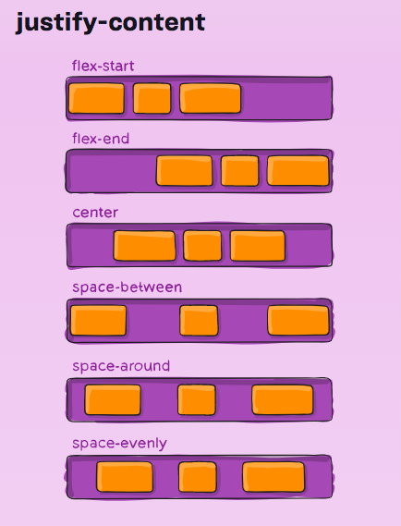
Why?

Slide 5
How?
CONTAINER ELEMENT
New CSS keyword: display (flex!)
Flex-direction, justify-content, align-items, gap
CHILDREN ELEMENTS
Automatically positioned
Can use flex: {number}; for weighting

Slide 6
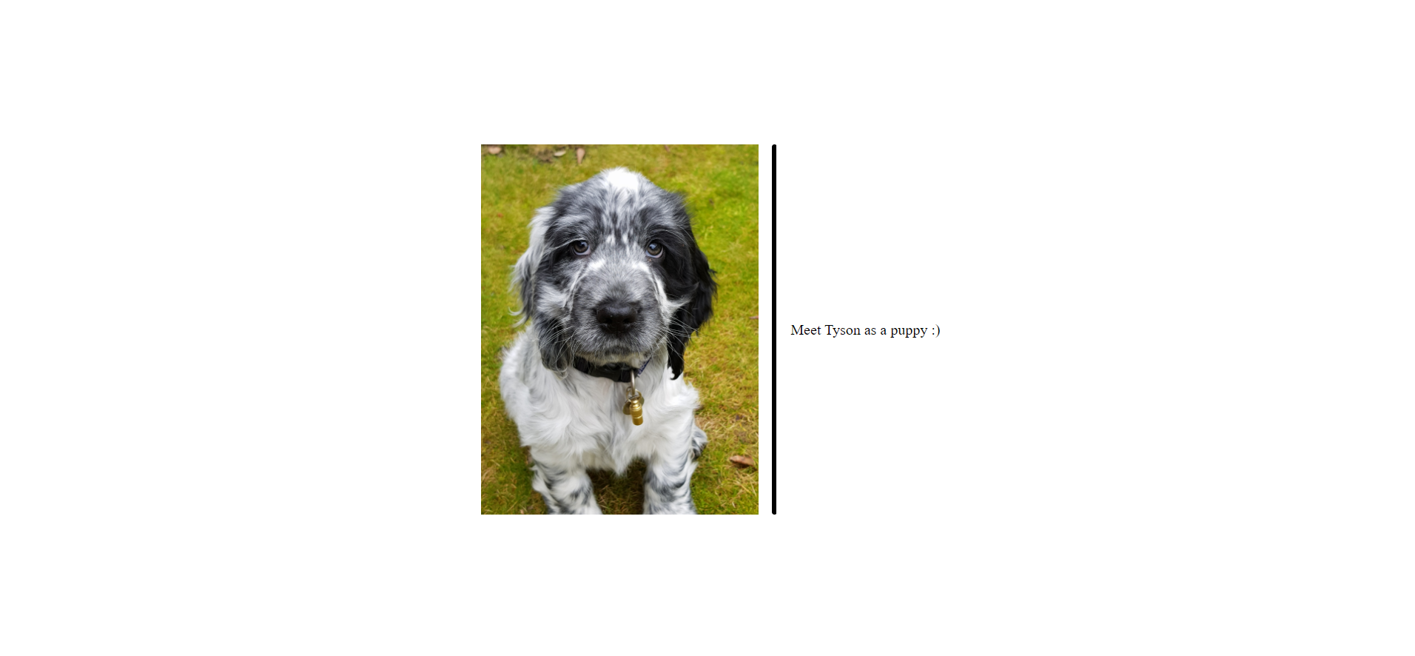
ExerCIse

